Slide 1
Barology: Behind The Lyrics
By:
Oluwapamilerin Amuda
And
Kerui Wu

Slide 2

Agenda
Introduction
Project Overview
Concept behind project
What is MAL?
What does our project entail?
Uses of Website
Demo

Slide 3
Project Overview
The goal behind this website was to create a safe haven for users to interact with other users who share the same taste in music.
The website will build a community where users of different cultures, languages and background can discuss lyrics to their favourite songs and artists.
Users can login to the website and see the comments of other users on what they think about a particular song or lyrics
Notes:
Think of it like a mindmap

Slide 4
Area of Focus
The two area of focus for us was
Area 4: Pulling real data from a database and local storage
And
Area 2: Javascript interactivity to improve user experience(e.g. from simple to more complex: mousehovers, form validation, hide/show, auto-completion, drag and drop,etc)

Slide 5
Concept Behind the Project
The driving force or concept for this project was MAL and rateyourmusic.
What is MAL?
MAL stands for My Anime List
myanimelist
MyAnimeList, often abbreviated as MAL, is an anime and manga social networking and social cataloging application website run by volunteers.
Notes:
MAL is used by a lot of anime fans and it holds an important job in the anime community.

Slide 6
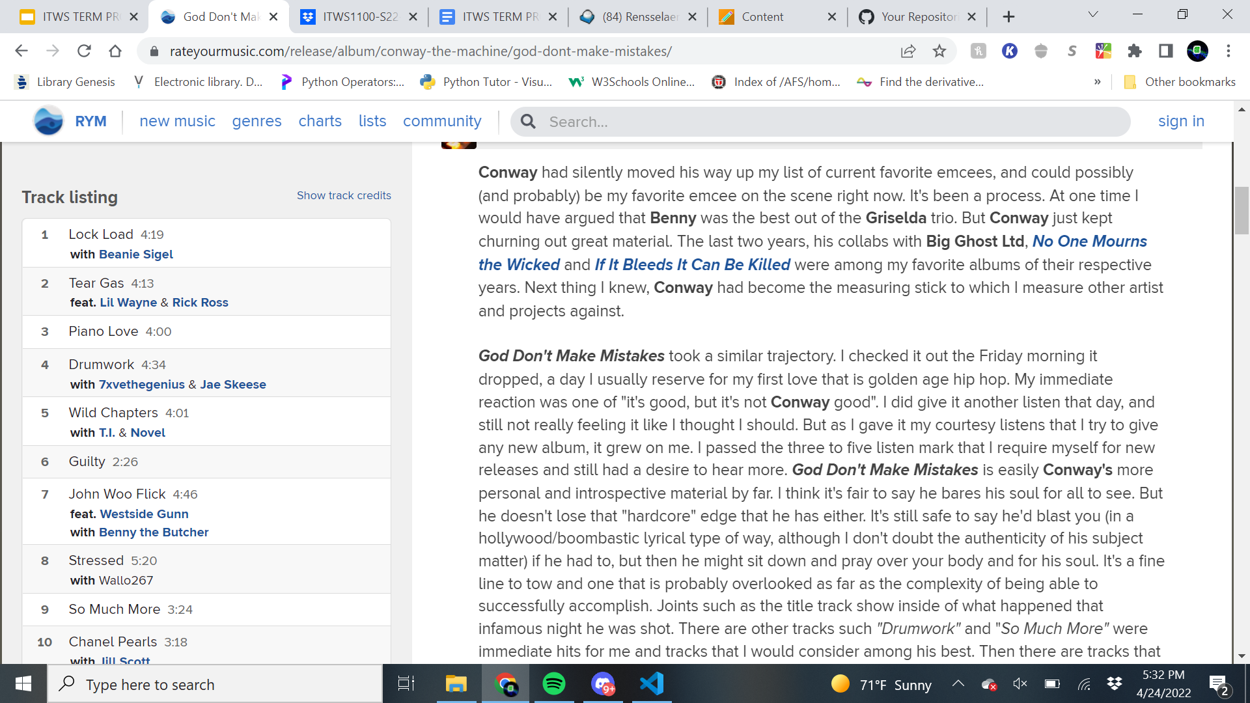
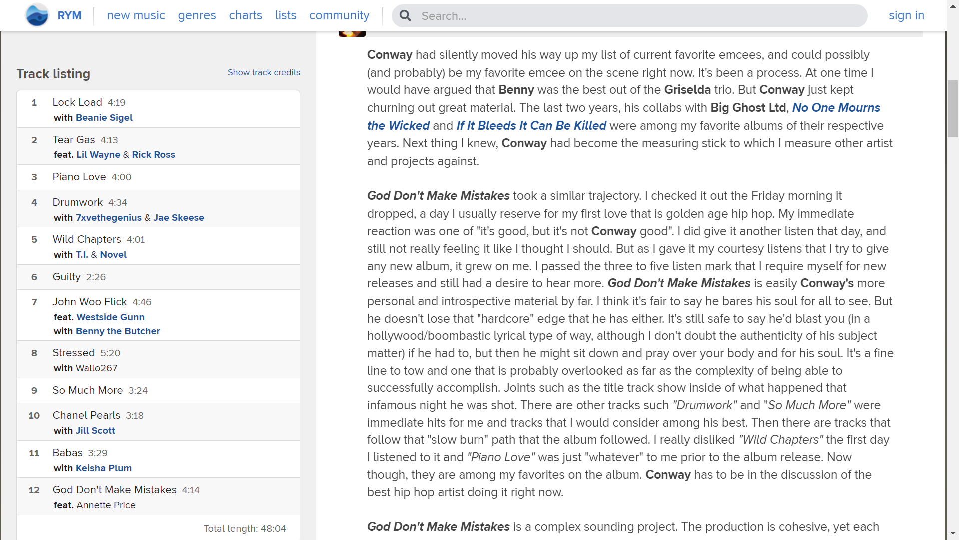
ScreenShots of RateYourMusic

Slide 7
Bridging The Gap
This will serve as a bridge of connection between users of different languages, cultures, and understanding of different music genres.
Take Hip-hop, for example, hip-hop is rooted in a lot of subliminal messages, stories, and metaphors that date back years since its inception.
This creates huge daunting tasks for new listeners of the genre because they are unable to properly understand the messages that are told by some artists in their songs.
They are now able to learn from other users as well as teach other users what they think a lyric or a song might be in general. Or they might have a personalized meaning to a song and share it with other users.
Notes:
This is where our website comes in, users are able to log into the website, and have discussions with other
They are now able to learn from other users as well as teach other users what they think a lyric or a song might be in general. Or they might have a personalized meaning to a song and share it with other users.

Slide 8
User Cases
User Case 1
A Chinese boy who like English lyrics, especially hip-hop music.
Too many complicated words, wordplays, complex punchlines because of culture gap.
User Case 2
Josh is a 20 year old college student and he’s a also a songwriter. He can login to the website and post his songs and let users live through the story he tried to tell.
Notes:
This is what will set us apart from our competitors. MAL and anilist is used by just anime fans, IMDB isn’t that mainstream among the younger generation. This is an area we can capitalize on

Slide 9

Features Of Website
Specialized comments for each lyrics
Ranking system
Targeted surveys
Reviews
Learning Center

Slide 10
What Makes Our Website Unique In a Saturated Market
Unique comments system
UI
Our features
Ability to post content
Media share
Various categories for searching
A user-centric website
Notes:
Most of our competitors either only focus one one form of entertainment
Or they aren’t big or mainstream enough. We plan on taking over that side that has been left alone by others.
Our website is an ever changing and evolving one to fit the climate of our industry
Websites like IMDB and anilist don’t offer most of the features we plan on offering such as a messaging, forums etc
Those who offer these features aren’t as detailed as we plan to implement
Our business model has already been made, we plan on perfection the already proven template for our users

Slide 11




Competition
As of 2022, there are a few competition in our market. Some of those competitions are
Myanimelist(MAL)
IMDb
Genius
Anilist
Notes:
There are some other website that try to attempt this formula but we aren’t going to talk about today.

Slide 12
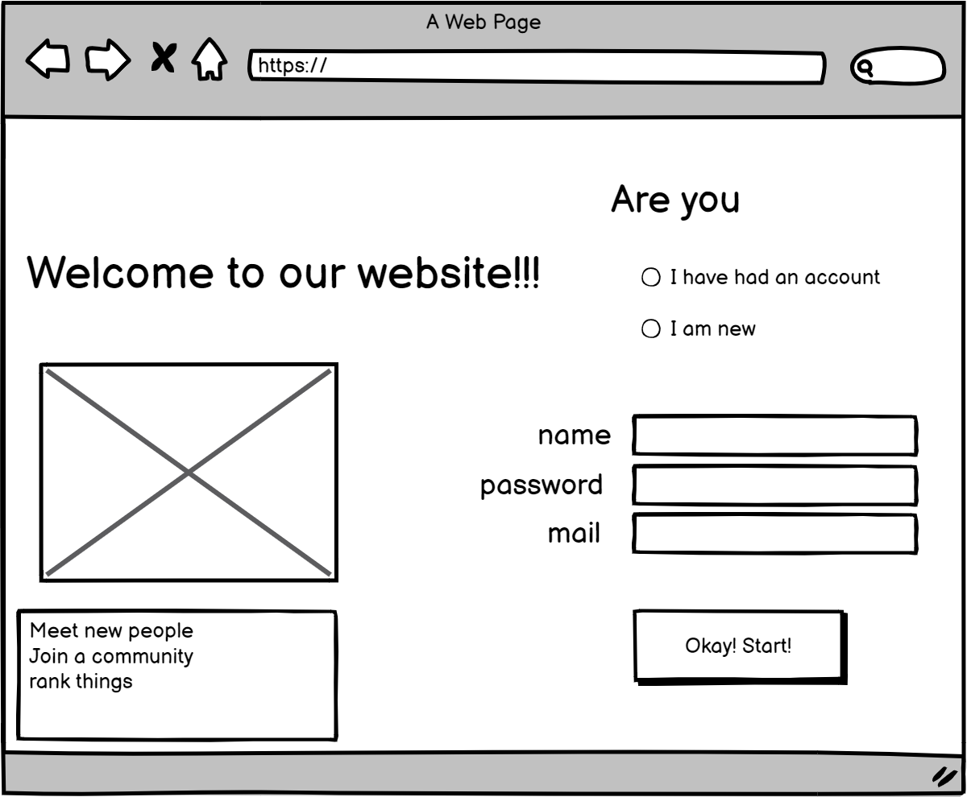
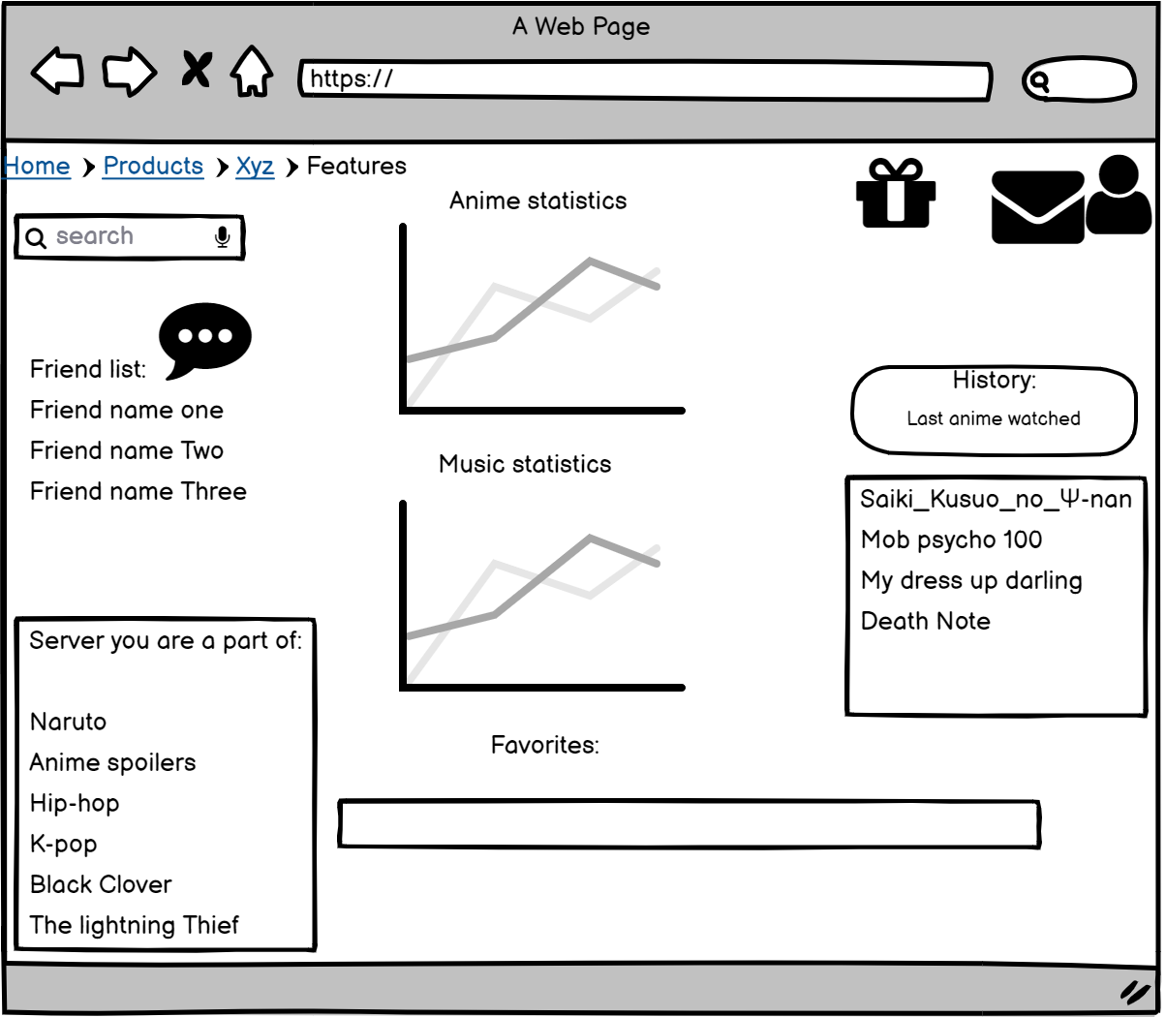
This is a users profile page. Here users and see their friends, servers they are a part of as well as statistics that relate to their usage on the website
Here is the landing page of the website. New users make account. While existing users login

Slide 13
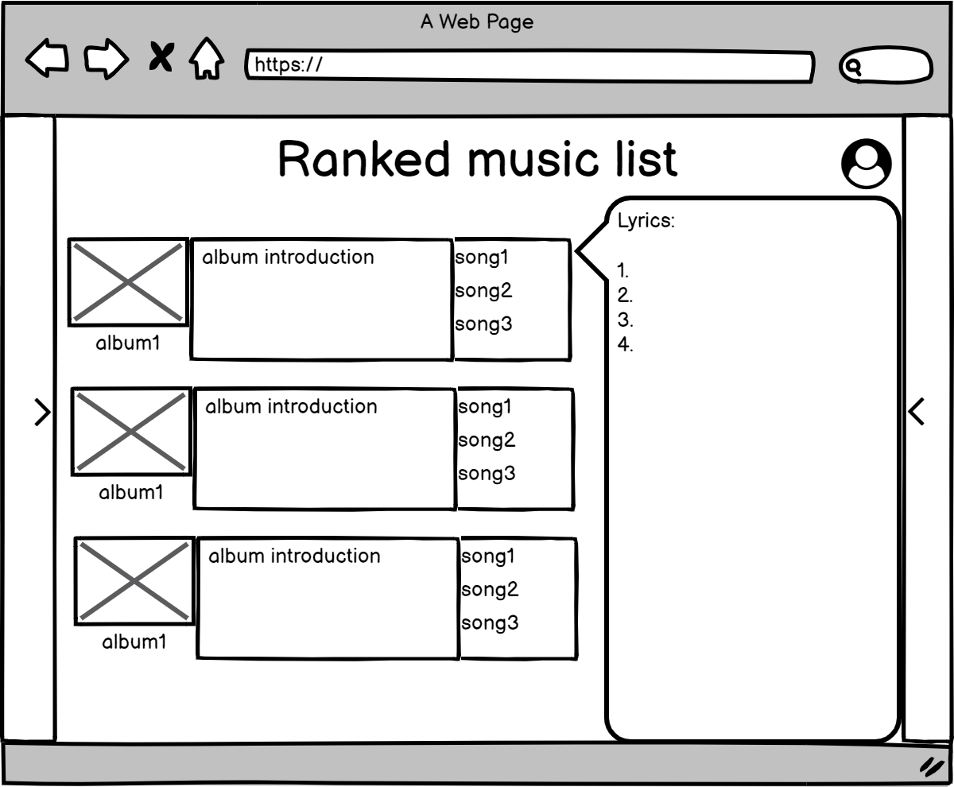
Users are able to rank anime and music using different criterias. Users can list animes they’ve completed, currently watching and i’s score on a scale of 1 to 10.

Slide 14
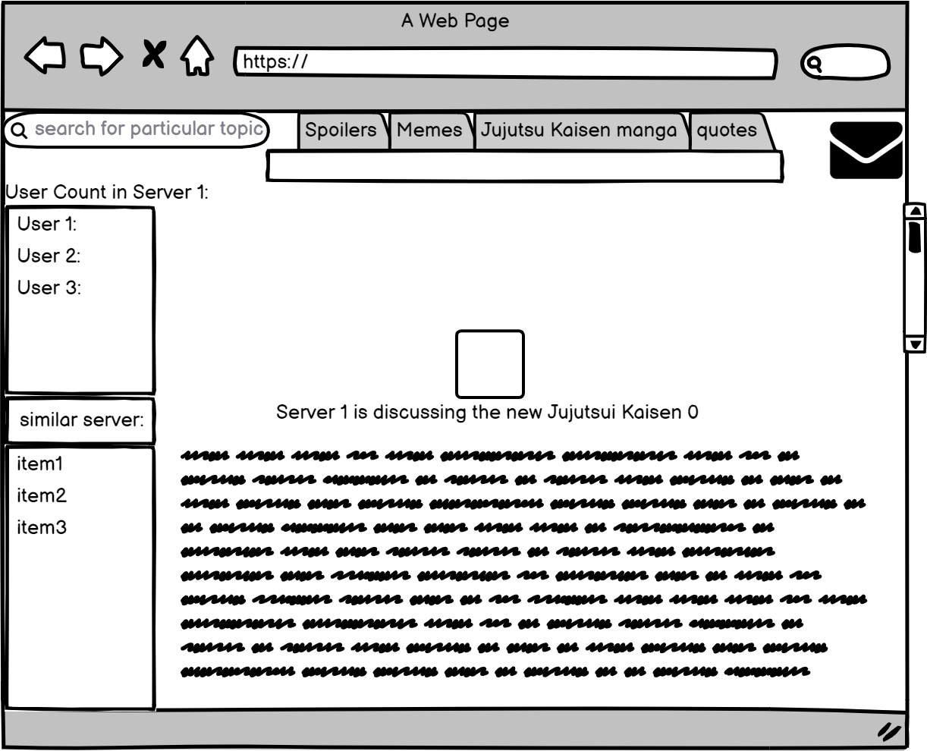
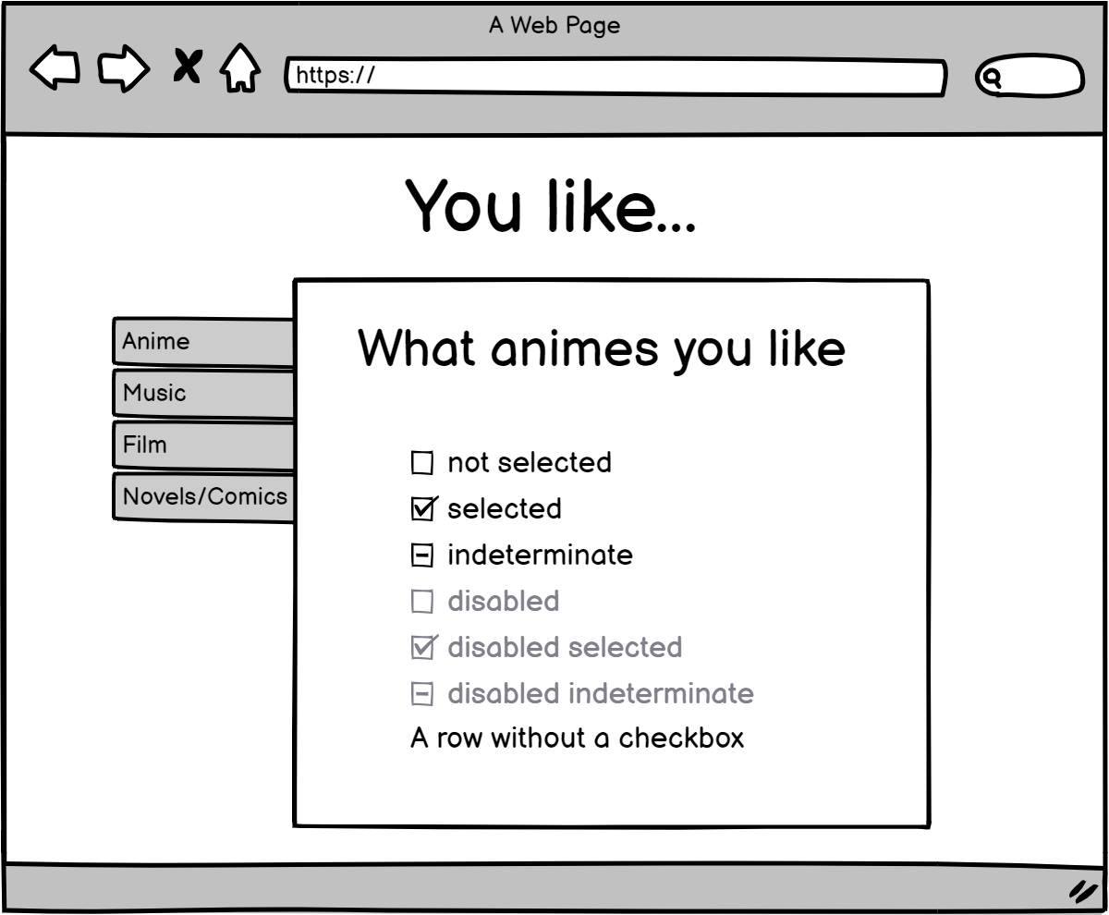
Users able to join groups/ servers of a specific topic or niche.

Slide 15
DEMO TIME

